Slide 1
Java Workshop 10 - Enums
Ben Schwarz

Slide 2
So what is an enum exactly?
An enum is kind of a class, with a predetermined list of objects with predetermined parameters.
It is used to keep constants as opposed to say an integer value or a string.

Slide 3


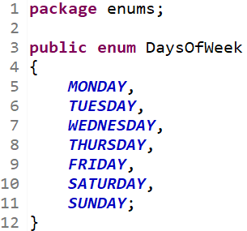
Enumerations
Trying to implement the simple enum shown using constants would require:
A class to reference them via
Assignment of unique integer values to each
A function to limit input values to one of these integers
Calls to said function from every reference

Slide 4
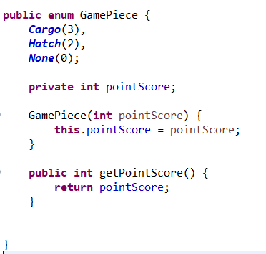
Enums Overview
Creating:
Replace the class keyword with enum
Defining Values:
-All Values go at the top of the enum.
-Values are separated by commas, with a semicolon at the end of the list.
-Forms are VAL or VAL(par1, par2, ...) if a constructor is defined

Slide 5
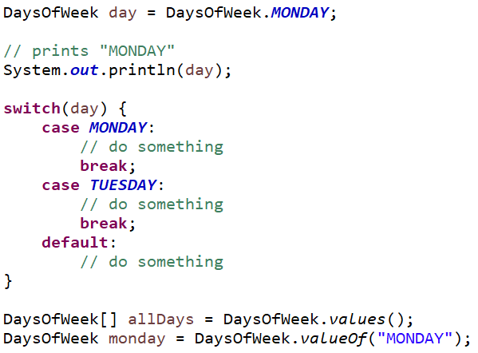



Using Enums
Enums function similarly to any other new datatype. Values can be accessed as if they were static constants stored in the enum.
There are also two functions provided by enums:
EnumName.values() gives an array of all values for an enum
EnumName.valueOf(string) gives the enum value with a given name
Additionally, the Enum class overrides toString() so that printing an enum value prints its name.

Slide 6
Other Enum Properties
Enums extend a java class (java.lang.Enum), and so cannot extend another class or enum
Enums can implement interfaces
Enum constructors must have a visibility modifier of private, or no modifier
Enums can have attributes and methods with any visibility
Enums can have abstract methods, which each value implements – we’ll cover this properly when we do anonymous classes

Slide 7
Your Turn
Create a Season enum, with required values
Create a Month enum
Months know which Season they belong to
A Month’s Season is visible, but not modifiable
Write a method for Season which gets an array of all Months in the Season
Challenge: Write methods for Month that
Return the next Month
Return the previous Month
Notes:
Previous workshops have been very concept-heavy, while for enums you just have to learn the syntax. Don’t overthink these tasks.
For the challenge, use Eclipse to investigate the methods for each enum value.

Slide 8
Summary
You should now be able to:
Identify the benefits of enums over magic numbers or lists of constants
Interpret an enum file to determine the list of values and their attributes
Create enums, with and without parameters
Use the built-in functions and methods of enums to navigate between ordered enum values, or iterate over all enum values

